Slide 1
Enhancing Plant Health with AI: Using Thermal and Image Processing
ECE 501
Instructor: Dr. Jafar Saniie
Summer 2023
Illinois Institute of Technology
Notes:
Zahra

Slide 2
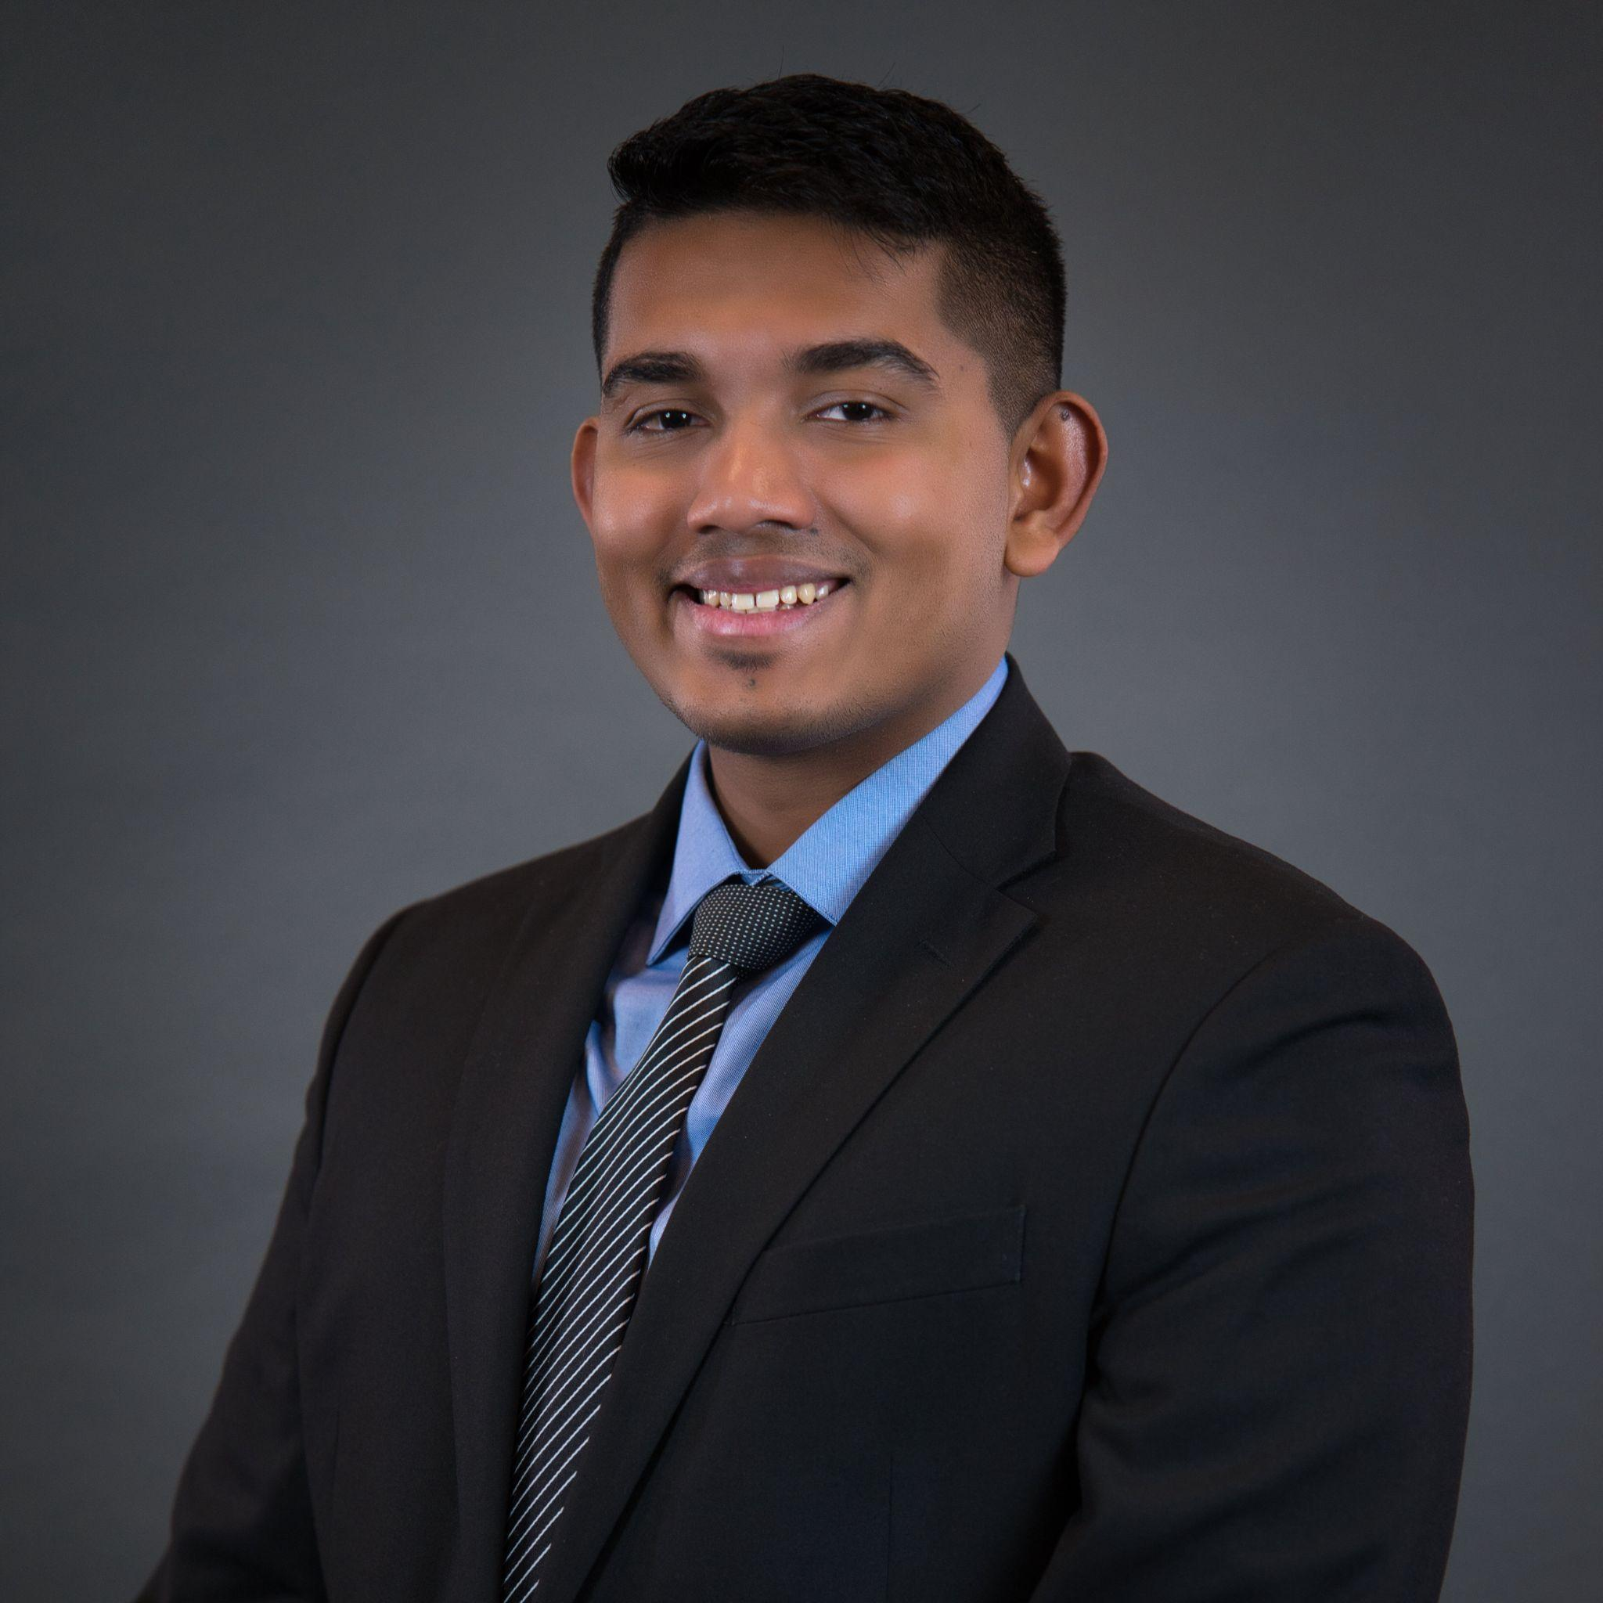
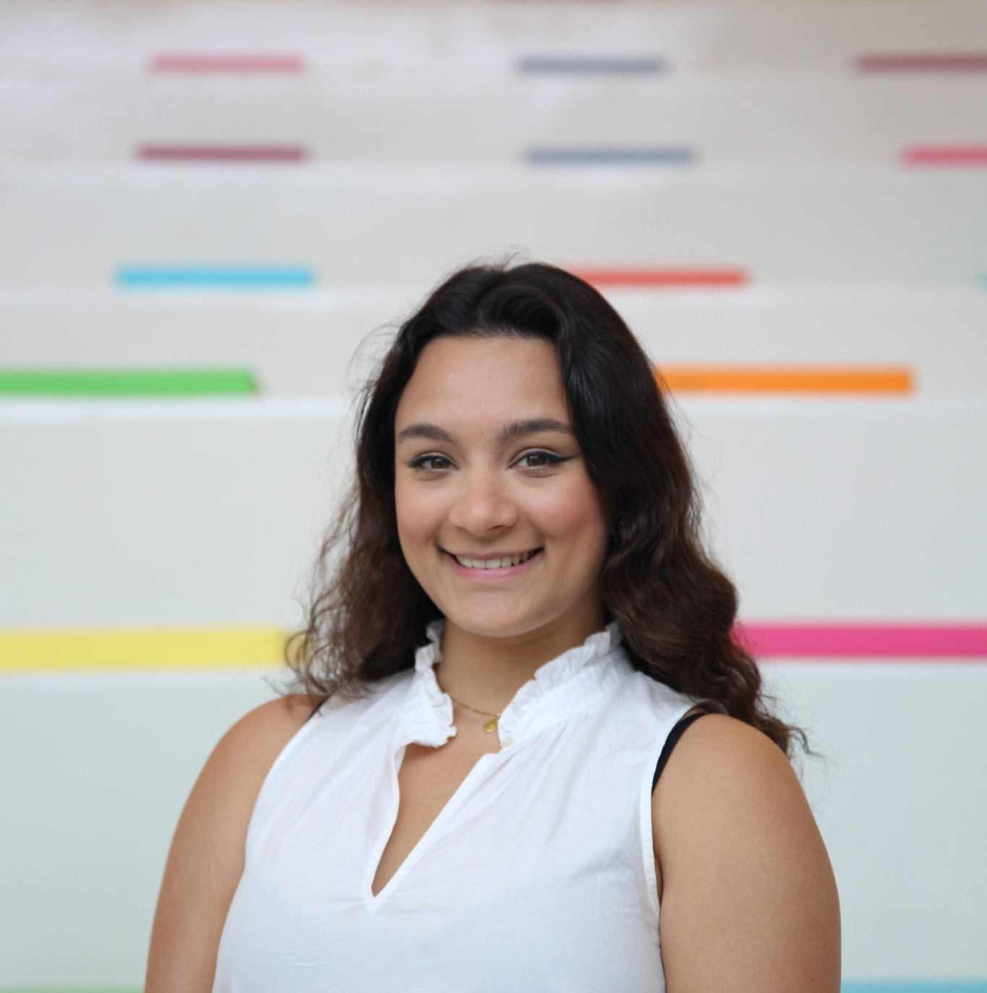

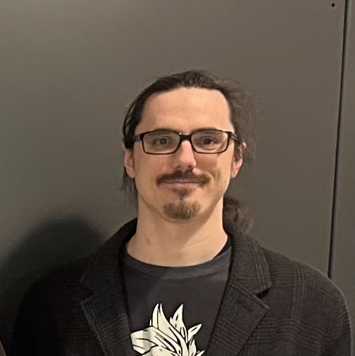
Meet the team:
Alan Palayil
Zahra Tolideh
Lukas Klicker
B.S. Computer and Cybersecurity Engineering
M.S Cybersecurity Engineering
B.S. Computer and Cybersecurity Engineering
M.S Computer Engineering
B.S. Electrical Engineering
M.S Computer Engineering
Notes:
Zahra

Slide 3
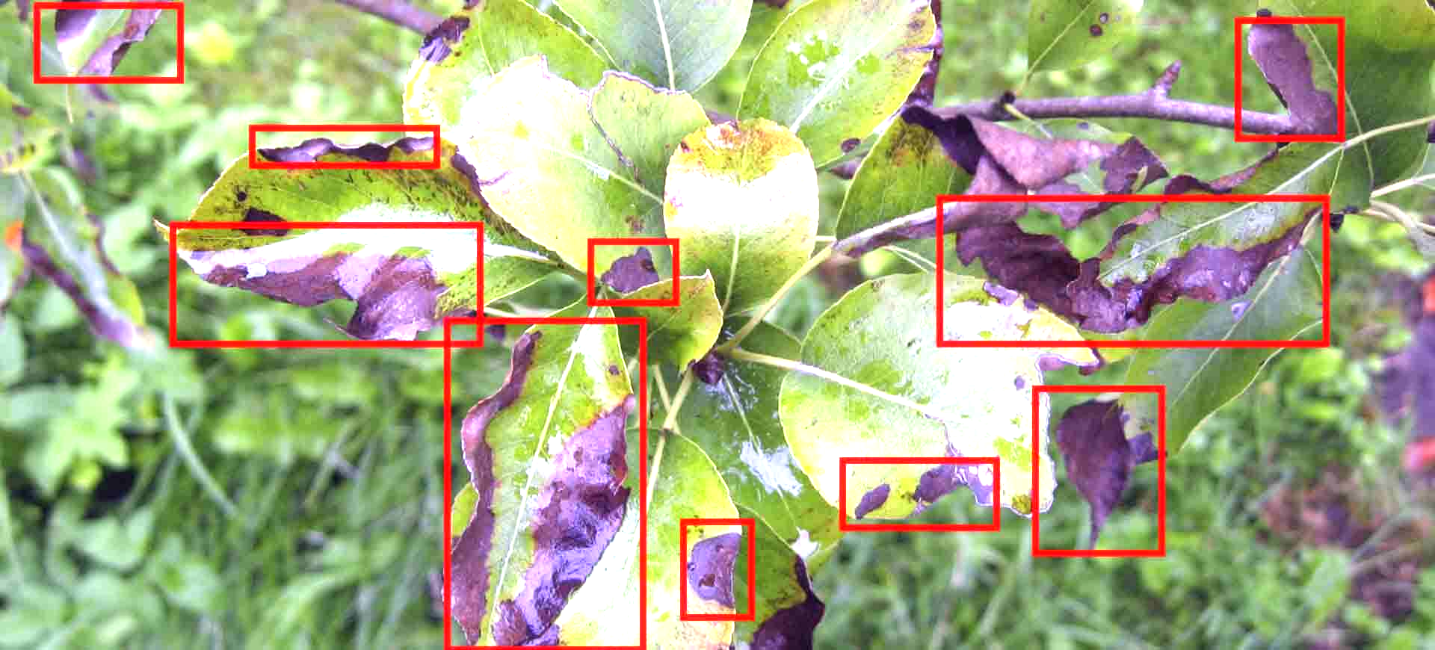
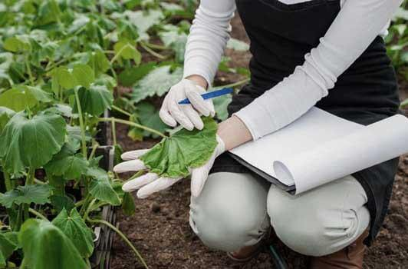
Our Project:
Objective:
Develop an integrated system for plant disease detection and classification that combines deep learning techniques with environmental sensors.
Our system aims to address these challenges by leveraging the power of deep learning algorithms and the valuable insights provided by environmental sensors.
Importance of the Project:
Plant diseases pose a significant threat to global food security and productivity, leading to substantial economic losses and reduced crop yields.
Early detection and accurate classification of plant diseases are critical for timely intervention and effective disease management strategies.
Expected Benefits:
Real-time disease detection and non-invasive monitoring.
Scalability and reduced reliance on manual inspection.
Deployment in diverse agricultural settings (farms, greenhouses, nurseries).
Assists farmers, agronomists, and researchers in disease management.
Notes:
Zahra

Slide 4
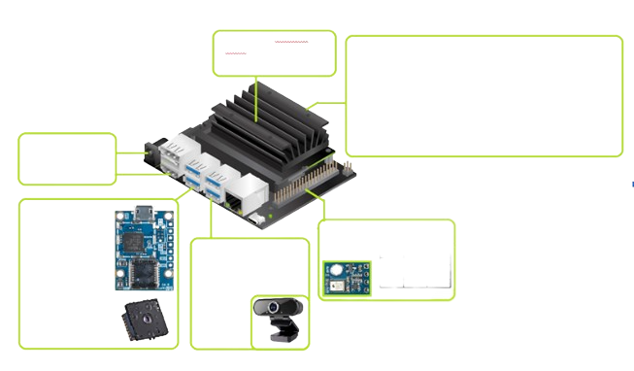
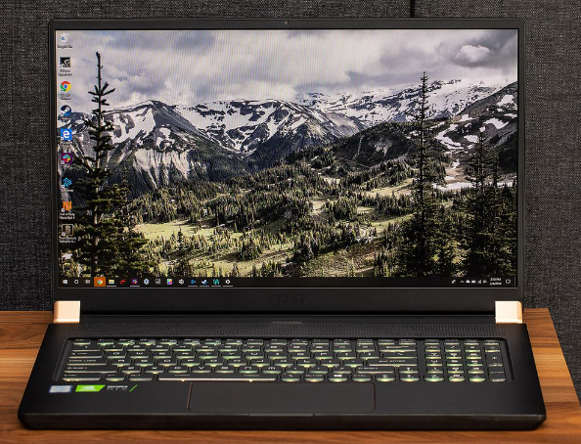
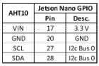
Hardware Layout:
Waveshare AC8265:
Wi-Fi Adapter
Jetson Nano 4GB
Jetpack 4.6.3 Linux 32.7.3
Jetson-Inference
CircuitPython
OpenCV 4.7
5V 4A DC Supply
HDMI - Monitor
PureThermal 2 Breakout Board
TELEDYNE FLIR Lepton 3.5 IR Camera
Temp Humidity Sensor
AHT10
Youlisn Webcam
Notes:
Lukas

Slide 5
Hardware:
Nvidia Jetson Nano:
The Jetson Nano is a powerful and compact central processing unit (CPU) specifically designed for AI applications. It provides high-performance computing capabilities for running complex deep learning algorithms.
USB Webcam:
The USB camera is responsible for extracting frames from the video feed in real-time. These frames are then passed to the deep learning model for analysis and disease detection. The USB camera plays a critical role in enabling real-time monitoring and proactive disease management.
AHT10 Sensor:
The AHT10 sensor is an environmental sensor that measures temperature and humidity levels. Humidity is an important factor in disease risk evaluation, as certain plant diseases thrive in specific humidity conditions. Humidity is used for both environment and leaf VPD measurements. Additionally the ambient air temperature can be used to improve the Thermal Imaging camera calibration threshold.
Laptop:
The laptop serves as the development and testing platform for the integrated system. It provides the necessary computational power to train and optimize the deep learning model
Notes:
Lukas

Slide 6
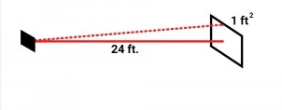
Hardware:
Thermal Camera Component | Lepton 3.5 | MLX90640
Manufacturer | FLIR | Melexis
Sensor Type | Microbolometer | Infrared Array
Resolution | 160x120 pixels | 32x24 pixels
Pixel Pitch | 12μm | 17μm
Field of View (FOV) | 50° H x 38° V | 55° H x 35° V
Temperature Range | -40°C to 150°C (-40°F to 302°F) | -40°C to 300°C (-40°F to 572°F)
Accuracy | ±5°C (±9°F) or ±5% of reading | ±2°C (±3.6°F) or ±2% of reading
Refresh Rate | 8.7 Hz (NTSC) / 7.5 Hz (PAL) | 0.5 to 64 Hz
Interface | SPI | I2C, SMBus
Operating Voltage | 2.8V - 3.3V | 3.3V
Power Consumption | 3.1V, 150mW (typical) | 3.3V, 85mA (typical)
IFOV(mrad) | 5.45 | 29.98
IFOV(inch) @ 10ft | 1.31 | 7.20
Thermographic Camera:
The thermal camera is a crucial hardware component used to capture thermographic images of plant leaves. These images provide valuable information which is essential for calculating the Leaf’s Vapor Pressure Deficit (VPD) value.
Teledyne FLIR’s Lepton 3.5 produces 5x the resolution of the MLX90640 features advance calibration settings. Usage of Long Wave Infrared Red increases accuracy of each pixel’s temperature measurement.
Group Gets PureThermal 2 Breakout board will provide USB communication.
[2]Lepton 3.5 https://www.flir.eu/products/lepton/
[3]MLX90640 datasheet https://www.melexis.com/en/documents/documentation/datasheets/datasheet-mlx90640
[4] FLIR Size Distance ratio thermal camera’s IFOV https://www.flir.com/discover/professional-tools/understanding-distancesize-ratio/
Notes:
Lukas

Slide 7
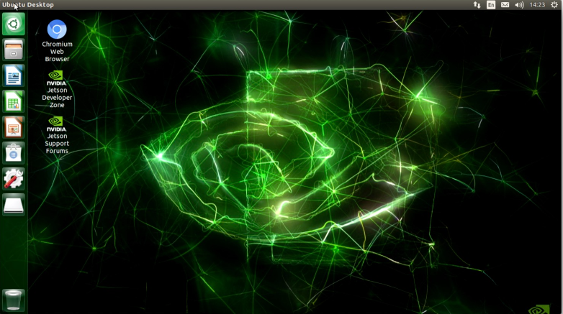




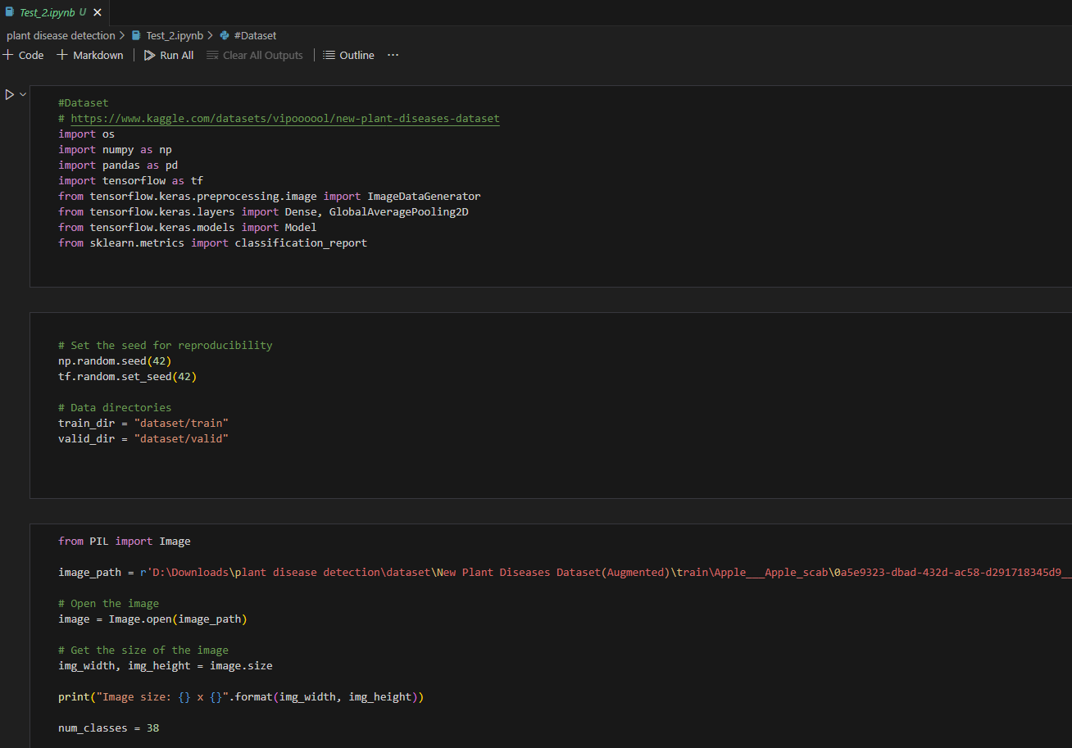
Software:
Base JetPack OS/Windows:
We use Jetson base OS for the camera and sensor while Windows for AI model.
TensorFlow (Deep Learning Model):
We leverage TensorFlow to build and train our CNN model. Our model is trained using a diverse dataset of plant images, including both visible and thermal images, to ensure robustness and accuracy.
Keras:
With Keras, we can define and configure our CNN model with minimal code, allowing for faster development iterations.
NumPy
We rely on NumPy to handle the numerical computations involved in data preprocessing, feature extraction, and model optimization.
OpenCV:
We utilize OpenCV for various image processing tasks, such as image enhancement, feature extraction, and data preprocessing.
Matplotlib:
We use Matplotlib to create visual representations of our data, such as graphs, charts, and plots.
Notes:
Zahra

Slide 8
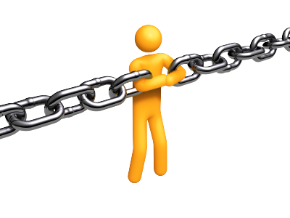
Constraints:
General Constraints:
Time duration to have extensive observations of the plants check on the minute changes.
Due to team members being at different locations and time zones, the whole project was done through remote collaborations.
Hardware Constraints:
The Jetson Nano was unable to read the digital signal from the DHT22 due to GPIO user permissions.
Thermal Camera MLX90640 resolution of 32x24 and even Lepton 3.5’s resolution of 160x120 do not provide thermographic images of high enough quality (pixel size) for effective disease analysis especially with distance.
Software Constraints:
Jetpack OS needs to updated in order to run latest tensorflow and other software.
Most datasets over the internet are large and that can overload the storage in the Jetson Nano.
Notes:
Zahra

Slide 9
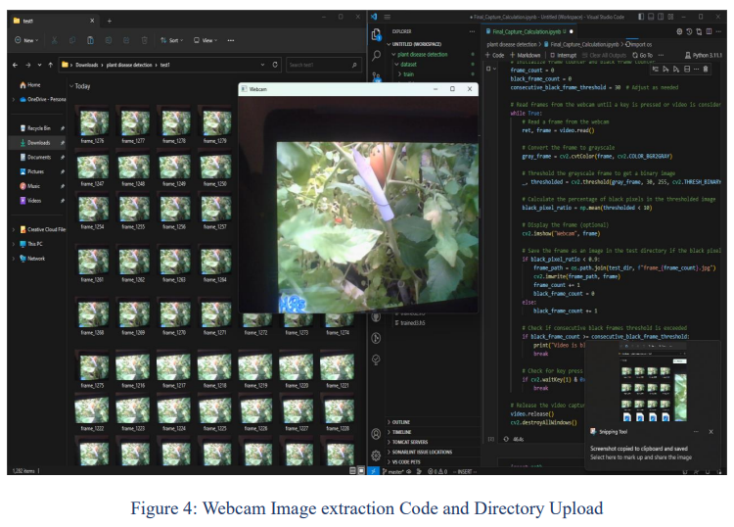
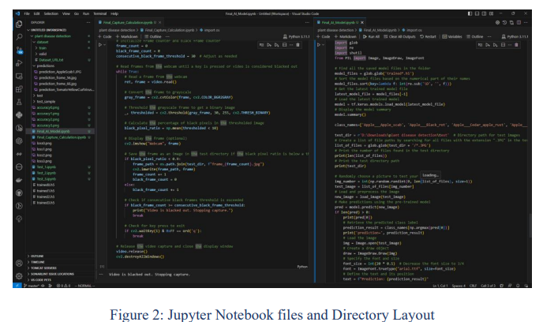
Project's Coding Methodology:
Data Output from Thermal Camera and AHT10 sensor:
Develop a Data Extraction Program for AHT10 Sensor and Thermal Camera to Populate a Database for VPD Application Integration.
Video Processing from the USB Camera:
The program utilizes OpenCV to convert the video feed from the camera into frames. The primary requirement is to save only the frames captured during periods without blackouts. These frames are then stored in the directory designated for use by the AI model.
Plant Identification and Disease Detection:
This Python program utilizes Keras from Tensorflow to identify plants based on their leaves, and incorporates a pre-existing dataset for disease detection. The program employs a pre-trained local model to continuously test and enhance its performance.
Notes:
Alan

Slide 10
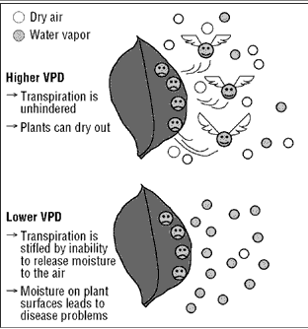
Project's Methodology:
Vapor Pressure Deficit (VPD):
Vapor Pressure Deficit (VPD)
Plant Transpiration
Water Management
Crop Health
Vapor Pressure Deficit (VPD) is a crucial parameter in irrigation that quantifies the drying power of the atmosphere.
Monitoring and managing VPD values enable efficient irrigation practices, water conservation, and improved crop health and productivity.
“VPD can be a limiting factor in plant growth. Climate change is predicted to increase the importance of VPD in plant growth, and will further limit growth rates across ecosystems”(Novick)
Novick, Kimberly A.; Ficklin, Darren L.; Stoy, Paul C.; Williams, Christopher A.; Bohrer, Gil; Oishi, A. Christopher; Papuga, Shirley A.; Blanken, Peter D.; Noormets, Asko; Sulman, Benjamin N.; Scott, Russell L. (November 2016). "The increasing importance of atmospheric demand for ecosystem water and carbon fluxes". Nature Climate Change. 6 (11): 1023–1027. doi:10.1038/nclimate3114. hdl:10150/622526. ISSN 1758-6798.
Notes:
Lukas

Slide 11
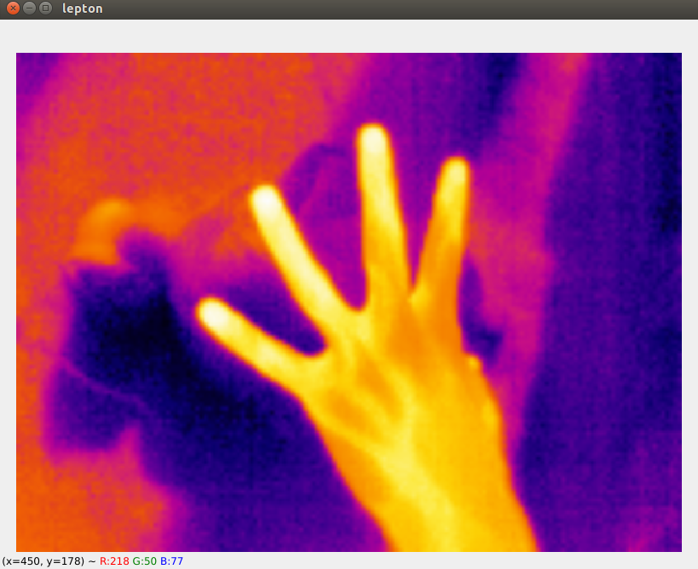
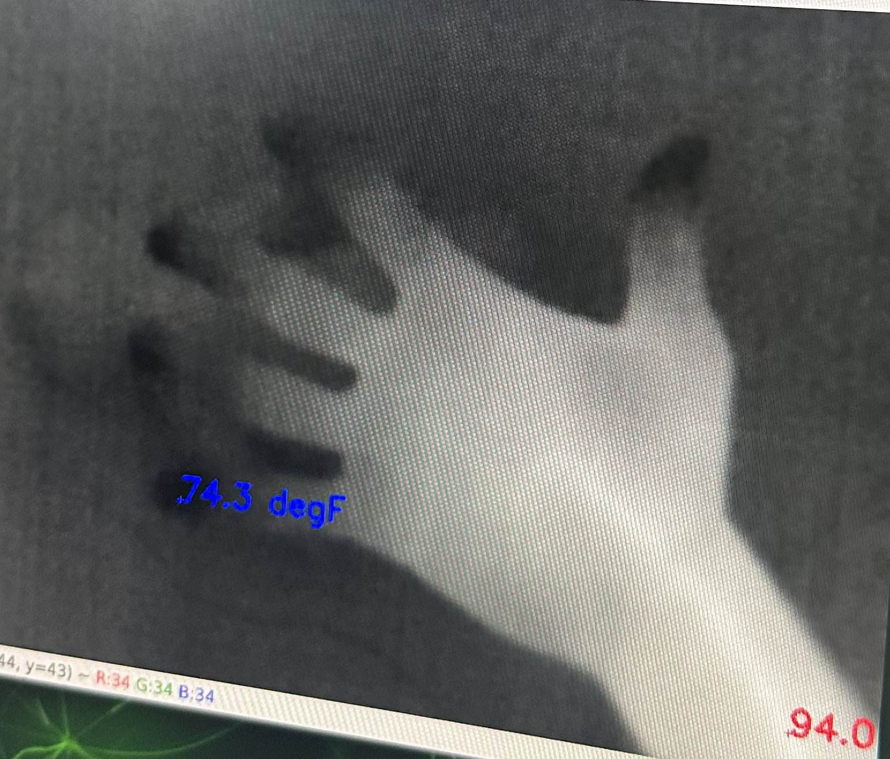
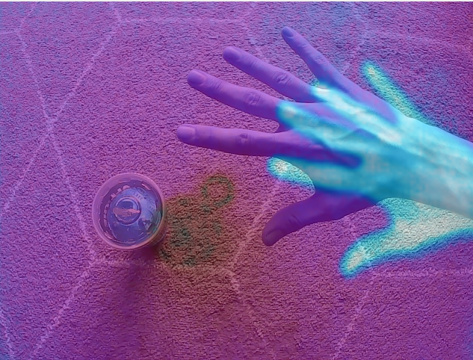
Results: Hardware
AHT10
Successfully extracted temperature & humidity values used for vpd and creating a csv format for extraction.
Webcam
Implemented USB Webcam with Higher resolution 1920x1080 @ 30 fps. Successfully used with detectnet to for use in object detection.
Lepton 3.5
Implemented new thermal imaging camera, successfully extraction of temperature values array for extraction.
Interpolation
Creation of interpolation script and determination of offset for accurate detected object measurements.
Notes:
Lukas

Slide 12
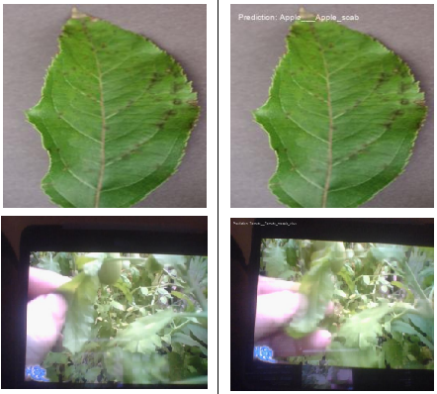
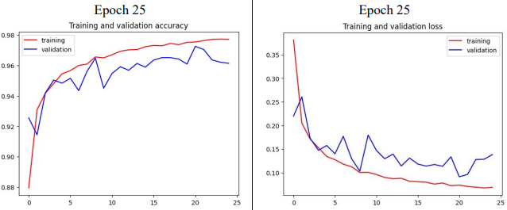
Results: Software
Dataset:
This dataset was characterized by its extensive volume of data, while surprisingly having a small storage size.
Video Processor
Integration of the video feed camera to AI model by extracting the frames from the video and feed it to test.
AI Model Training
Through the utilization of CNN, the model demonstrated robust performance in disease prediction with a target accuracy of 90% or higher.
Notes:
Alan

Slide 13
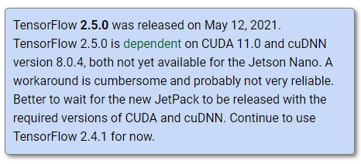
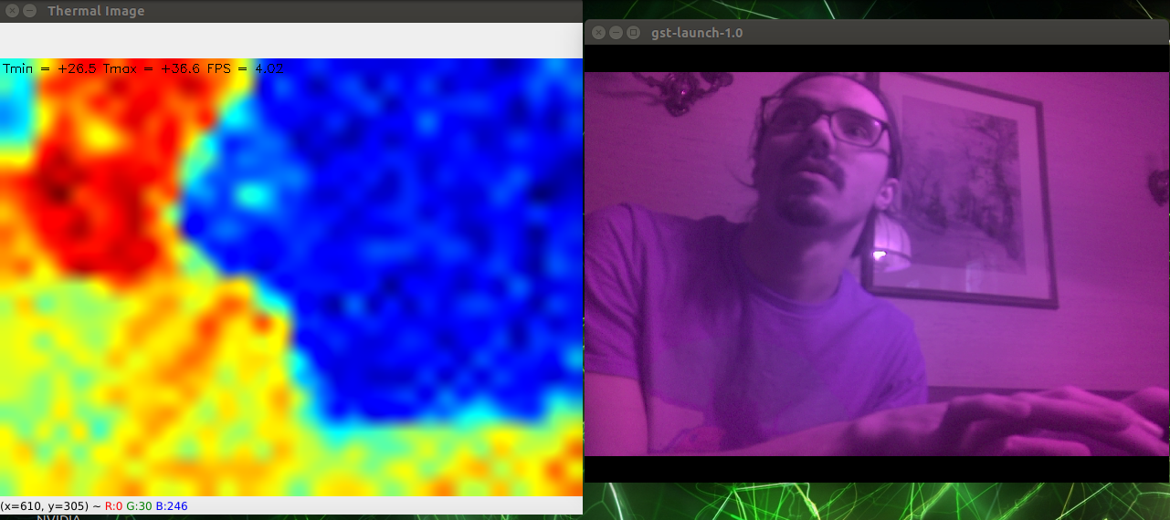
Challenges:
Library installation and compatibility issues:
Integrating different libraries and frameworks, such as TensorFlow, Keras, OpenCV, and NumPy, can sometimes lead to compatibility conflicts and installation difficulties.
Finding suitable dataset for training:
Collecting a dataset that includes various plant diseases, captured under different conditions, required extensive research, data collection, and data preprocessing.
Integration of Webcam and thermographic camera:
Integrating multiple hardware components, such as the MIPS camera for real-time image analysis and the thermal camera for temperature measurement, required careful calibration and synchronization.
Data extraction from thermal images:
Extracting meaningful data from thermal images for disease detection and temperature analysis presented a challenge. Developing image processing techniques to extract relevant features and accurately interpret the thermal data demanded experimentation and fine-tuning.
Limited computational resources:
The project's computational demands, particularly during training and optimization of the deep learning model, required substantial computing power.
Notes:
Alan

Slide 14

Milestones:
Installation and Configuration of Libraries:
This milestone involved setting up the necessary software libraries and frameworks required for the development and implementation of the integrated system.
Dataset Acquisition and Preprocessing:
This milestone involved sourcing and curating a dataset that covers various plant species and a wide range of diseases.
Integration of Thermal Imaging and AHT10 Sensor:
This milestone involved connecting and integrating these components into the hardware setup, enabling the system to measure leaf temperature and humidity accurately.
Integration of USB Camera for Real-time Analysis:
This milestone focused on seamlessly incorporating the Webcam camera, enabling the extraction of frames for immediate analysis by the deep learning model.
Training and Optimization of AI Model:
This milestone involved training the model using the curated dataset, leveraging the power of convolutional neural networks (CNN).
Results and Performance Evaluation:
The final milestone involved evaluating the performance of the integrated system and the trained AI model.
Notes:
Zahra

Slide 15
Work Distribution:
Name | Task Distribution
Alan Palayil | Gathered a dataset specifically focused on plant diseases, encompassing a wide range of plant ailments. Designed the AI model architecture to address both plant detection and disease classification. Developed a program that could extract frames from the camera feed and input them into the AI model for analysis.
Zahra Tolideh | Created the VPD (Vapor Pressure Deficit) calculation program, which played a crucial role in assessing the plant's irrigation needs. Designed irrigation strategies based on predefined metrics, leveraging the VPD calculations to determine optimal watering requirements.
Lukas Klicker | Was responsible for the hardware setup, ensuring all components were properly connected and functioning. Worked on enabling thermal imaging to work simultaneously with the USB camera, synchronizing and calibrating the two sources. Focused on extracting data from the thermal images, developing the necessary algorithms to process and extract relevant information. Developed a program that could extract data from the AHT10 sensor, which measured environmental humidity, and input it into the VPD program for analysis.
Notes:
Alan

Slide 16
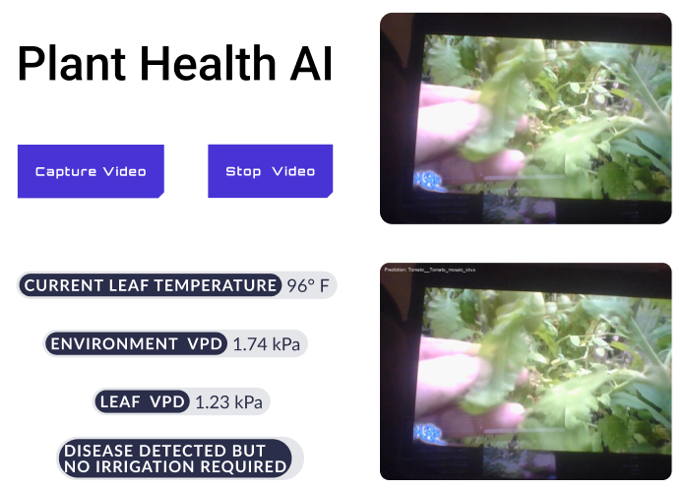

Future Works:
Software Upgrades:
Current Jetpack OS only has TensorFlow (2.4.0) and to run the AI model, we need to wait for Nvidia to update to (2.12.0).
Cloud Implementation:
To overcome the limitations of running the project solely on Jetson, a future enhancement could involve implementing a cloud-based solution.
Web User Interface (UI):
Developing a web-based user interface would greatly enhance the project's usability and accessibility.
Data Visualization and Analytics:
Enhancing the project's analytical capabilities by incorporating advanced data visualization and analytics tools can provide deeper insights into plant health trends, disease patterns, and overall crop performance.
Integration with IoT and Automation:
Integrating the project with Internet of Things (IoT) technologies and automation systems would enable real-time monitoring, remote control, and autonomous operation.
Notes:
Alan

Slide 17
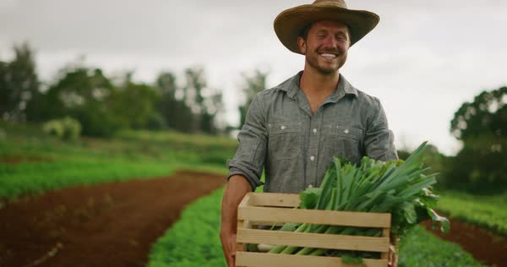
Conclusion:
Integrated system combines deep learning and environmental sensors for plant disease detection:
This approach to plant disease detection and classification empowers farmers and researchers with a powerful tool for sustainable crop production.
Utilizes convolutional neural networks (CNNs) for accurate disease classification:
The successful implementation of the system is evidenced by achieving a target accuracy of 90% or higher in disease classification.
Hardware components work seamlessly to capture and process critical data:
The system's hardware components work together seamlessly to capture and process critical data
Provides real-time disease detection, non-invasive monitoring, and scalability for diverse agricultural settings:
The rigorous training and optimization of the AI model, combined with the accurate VPD calculation and real-time analysis, contribute to the system's effectiveness in disease prediction.
Notes:
Alan

Slide 18
Project Demonstration
Presentation on the Current Progress:
A Visual Journey between Hardware and Software
Notes:
Alan

Slide 19
Research References:
“Advances in Remote Sensing.” SCIRP. Accessed May 17, 2023.
https://www.scirp.org/journal/ars/.
Application of infrared thermography for irrigation scheduling of ... Accessed May 17, 2023.
https://www.researchgate.net/publication/355906427_Application_of_Infrared_Thermogr aphy_for_Irrigation_Scheduling_of_Horticulture_Plants.
Author links open overlay panel Olivier Debauche a b, a, b, c, d, and Abstract Overcoming population growth dilemma with less resources of soil and water. “Edge Ai-IoT Pivot Irrigation, Plant Diseases, and Pests Identification.” Procedia Computer Science, November 11, 2020.
https://www.sciencedirect.com/science/article/pii/S1877050920322742.
Cloud of things in smart agriculture: Intelligent ... - IEEE xplore. Accessed May 18, 2023.
https://ieeexplore.ieee.org/document/7879140.
Thermal imaging for Smart Agriculture Irrigation System to support ir 4 ... Accessed May 18, 2023.
https://www.researchgate.net/profile/Aznida-Abu-BakarSajak/publication/344862746_Thermal_Imaging_for_Smart_Agriculture_Irrigation_System_to_support_IR_40_Initiative/links/5f945127299bf1b53e40d24d/Thermal-Imagingfor-Smart-Agriculture-Irrigation-System-to-support-IR-40-Initiative.pdf
Notes:
Lukas

Slide 20
Other References:
Pratikkayal. “Pratikkayal/PlantDoc-Dataset: Dataset Used in ‘Plantdoc: A Dataset for Visual Plant Disease Detection’ Accepted in Cods-COMAD 2020.” GitHub. Accessed June 10, 2023.
https://github.com/pratikkayal/PlantDoc-Dataset.
Bhattarai, Samir. “New Plant Diseases Dataset.” Kaggle, November 18, 2018.
https://www.kaggle.com/datasets/vipoooool/new-plant-diseases-dataset.
“Papers with Code - Plantdoc Dataset.” Dataset | Papers with Code. Accessed June 10, 2023.
https://paperswithcode.com/dataset/plantdoc.
“API Documentation: Tensorflow V2.12.0.” TensorFlow. Accessed June 10, 2023.
https://www.tensorflow.org/api_docs.
Team, Keras. “Keras Documentation: Keras API Reference.” Keras. Accessed June 10, 2023.
https://keras.io/api/.
OpenCV documentation index. Accessed May 28, 2023.
https://docs.opencv.org/.
Notes:
Lukas

Slide 21
Thank You!
We are open to Q&A now
Notes:
Alan

